Slide 1
Scuba Chat
Project Specifications
Akshaya Bhat, Lilian Vu, Sienna Landa, Sophie Harris

Slide 2
Project Overview

Slide 3

Overall Objective
Create an underwater transmitter and receiver using a piezoelectric transducer to generate ultrasound waves
Implement the transceiver on our PYNQ FPGAs and ARM cores, with analog elements limited to the transducers, amplifiers, and a bandpass filter on the receiver side.

Slide 4
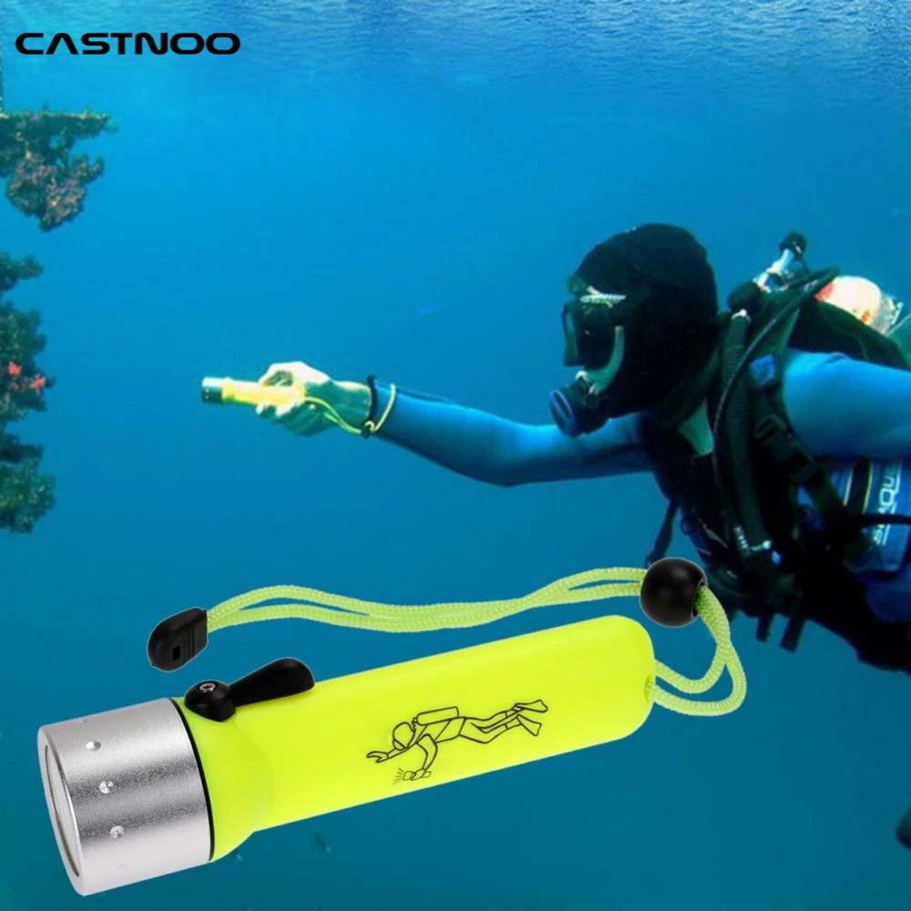
Application
Underwater communication is useful for many:
Researchers
Underwater welders and other industrial workers
Scuba divers and underwater cave explorers
Currently most underwater communication devices are specialized and developed for high budget projects (e.g. military)
There are few affordable underwater communication devices on the market, and there is lots of work to be done with open source / research focused underwater communications.

Slide 5
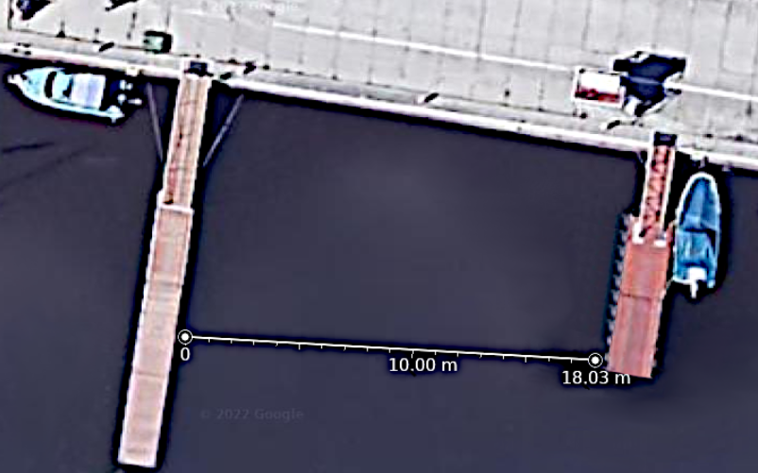
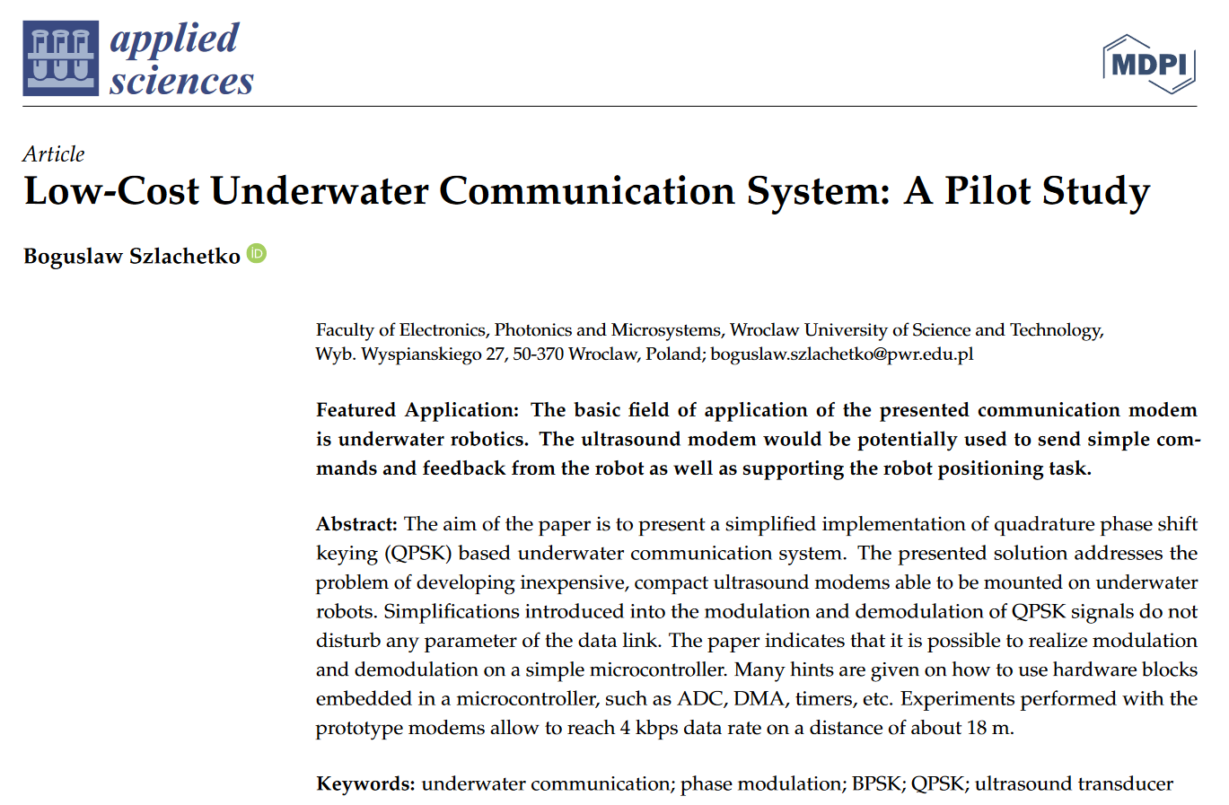
Existing Work
A 2022 paper (Low-Cost Underwater Communication System: A Pilot Study by Boguslaw Szlachetko, 2022) introduced a prototype for a low cost ultrasonic communicator
Used only a microcontroller and commercially available piezoelectric transducer
40 kHz carrier frequency
QPSK modulation, 4 kbps
Noncoherent demodulation because they did not have PLL block
Single transmitter, single receiver

Slide 6

Minimum Viable Product (MVP)
Basic Goals:
Successfully send information over the underwater acoustic channel
Prototype PYNQ boards with waterproof transducer cabled to it that can be dipped several feet into the water or a swimming pool or lake to send data
Create one Transmitter and one Receiver for one way communication.
Have a high enough data rate to send small snippets of text without noticeable delay
Bit error rate should be around 1% (10⁻²)

Slide 7
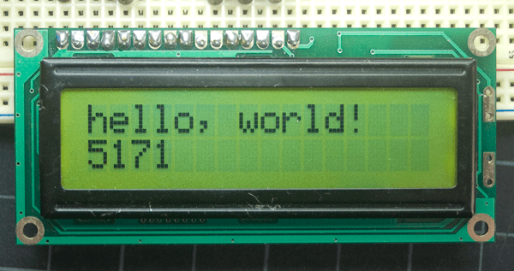
Stretch Goals
Two-way communication using a switch
Waterproof plastic casing to bring the whole system underwater
Front End Interface or LCD to display messages
Test system in a ocean environment

Slide 8
Project Approach

Slide 9

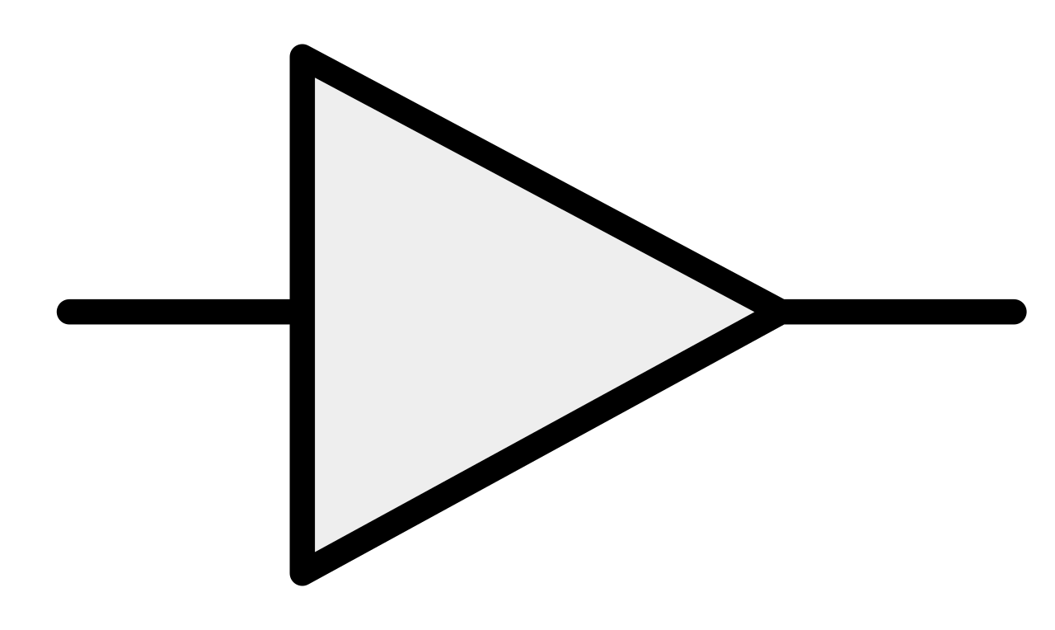
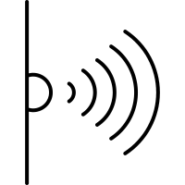
Block Diagram
PYNQ
ARM
FPGA
40kHz
Waveform Generation
Encoding
QPSK Modulation
DAC
Display
Decoding
QPSK Demodulation
ADC

Slide 10
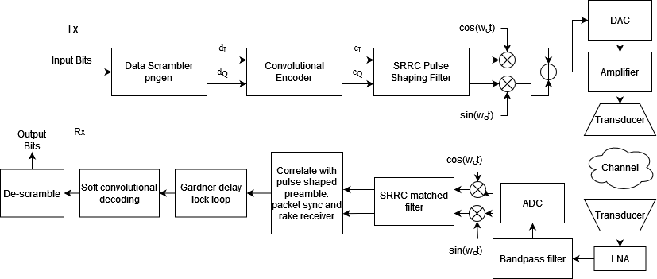
Tx/Rx Design

Slide 11
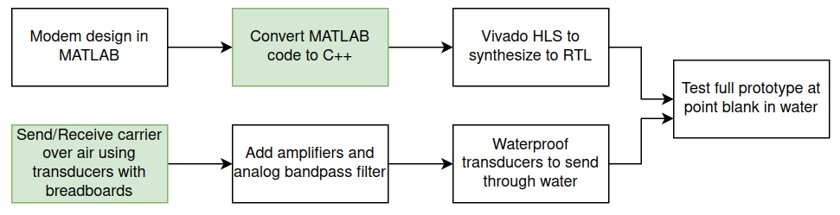
Design Flow
Work In Progress

Slide 12
Constraints, Risk, and Feasibility

Slide 13
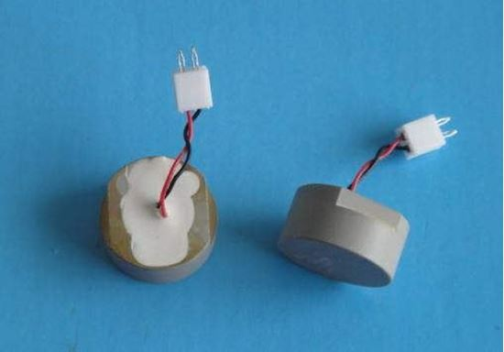
Risk: Hardware Design
Communication between Tx and Rx Transducers
Analog filters, amplifiers, and other components

Slide 14
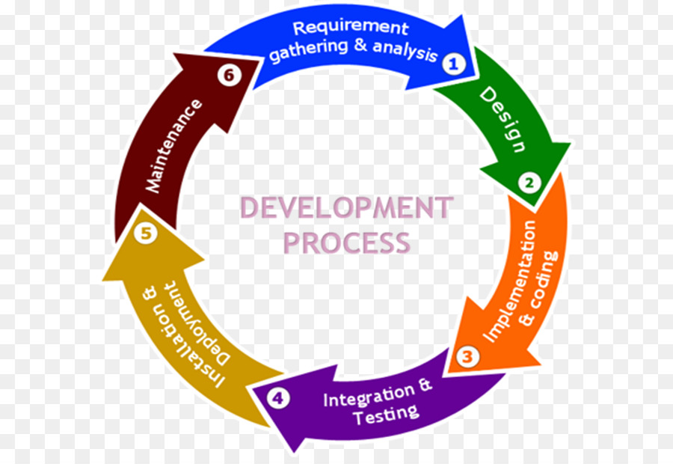
Risk: System Integration
Erroneous synchronization of samples coming from ADC
Incorrectly handling DMAs

Slide 15
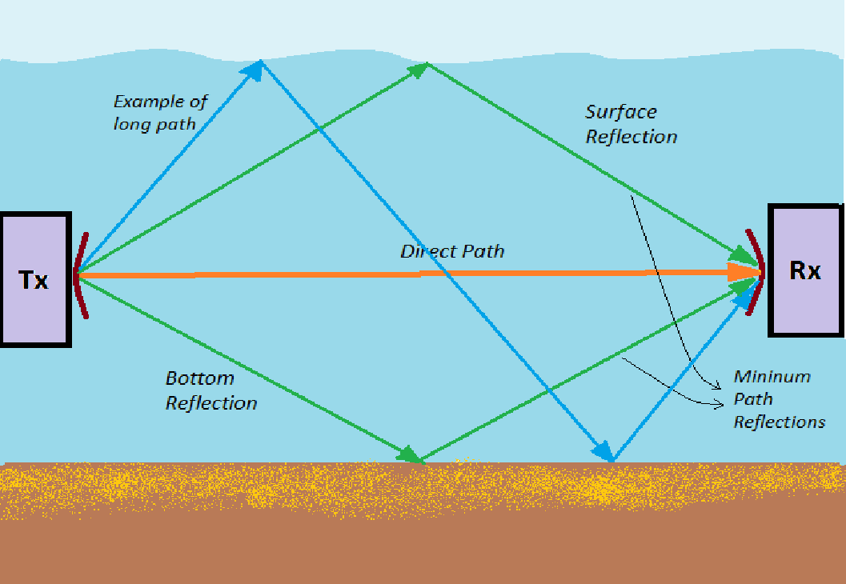
Risk: Channel
From a simulated channel to a real-world channel, unforeseen problems could arise and our transceiver could be not robust enough to handle the problems of the underwater acoustic channel
Possibility of our transmitter and receiver designed not being enough could cause confusion

Slide 16
Project Development

Slide 17
Group Management
Software Team
Hardware Team
Sophie
Matlab implementation of Tx and Rx
Translate Matlab to C++ for Rx
BER Simulations in Matlab
Matlab simulation of the Channel
Akshaya
Viterbi decoder (software)
Integrate Amplifier with the transducer circuit.
Basic underwater signal TX/RX testing.
Programming the transducer connected to PYNQ.
Collaboration
Overall integration
Testing
Debugging
Discussions
Lilian
Translate Matlab to C++ for Tx and Rx
DMA testing with FPGA IP Core on PYNQ
DAC/ADC Integration with PYNQ
Sienna
Standalone Circuit design for transducer interface
Integrate Amplifier with the transducer circuit.
Basic underwater signal TX/RX testing.
Programming the transducer connected to PYNQ.

Slide 18
Hardware Components
Hardware: PYNQ board, transducer, amplifier, breadboards and wiring.
Software: Matlab, Vitis HLS, Linux kernel, Python.
Hardware | Cost
3 X Transducers pair | $45
2 X Amplifier | $10
Breadboards and connecting wires | $10

Slide 19

Testing and Documentation
We intend to perform end-to-end data communication between the setups where only the transducers will be underwater. We will test for data integrity in the still water first and then move on to a noisier environment if time permits.
Our documentation will be:
Regularly updated as part of our Progress report.
README.md of our github.
We will also update comments throughout our code when possible.

Slide 20
Project Milestones and Schedule

Slide 21
Milestones for Spring Quarter
- Tx and Rx Simulations in Matlab
- Standalone Tx and Rx Transducers testing
- Configure LEDs on PYNQ
- Configure Buttons on PYNQ
- Integrate the amplifier to the TX circuit
04/20
05/14
05/29
03/16
04/24
05/24
- Integrate Tx and Rx Transducer Circuits with
PYNQ
- Integrate Hardware and Software
- Interface the transducer with PYNQ
- Implement User Interface

Slide 22
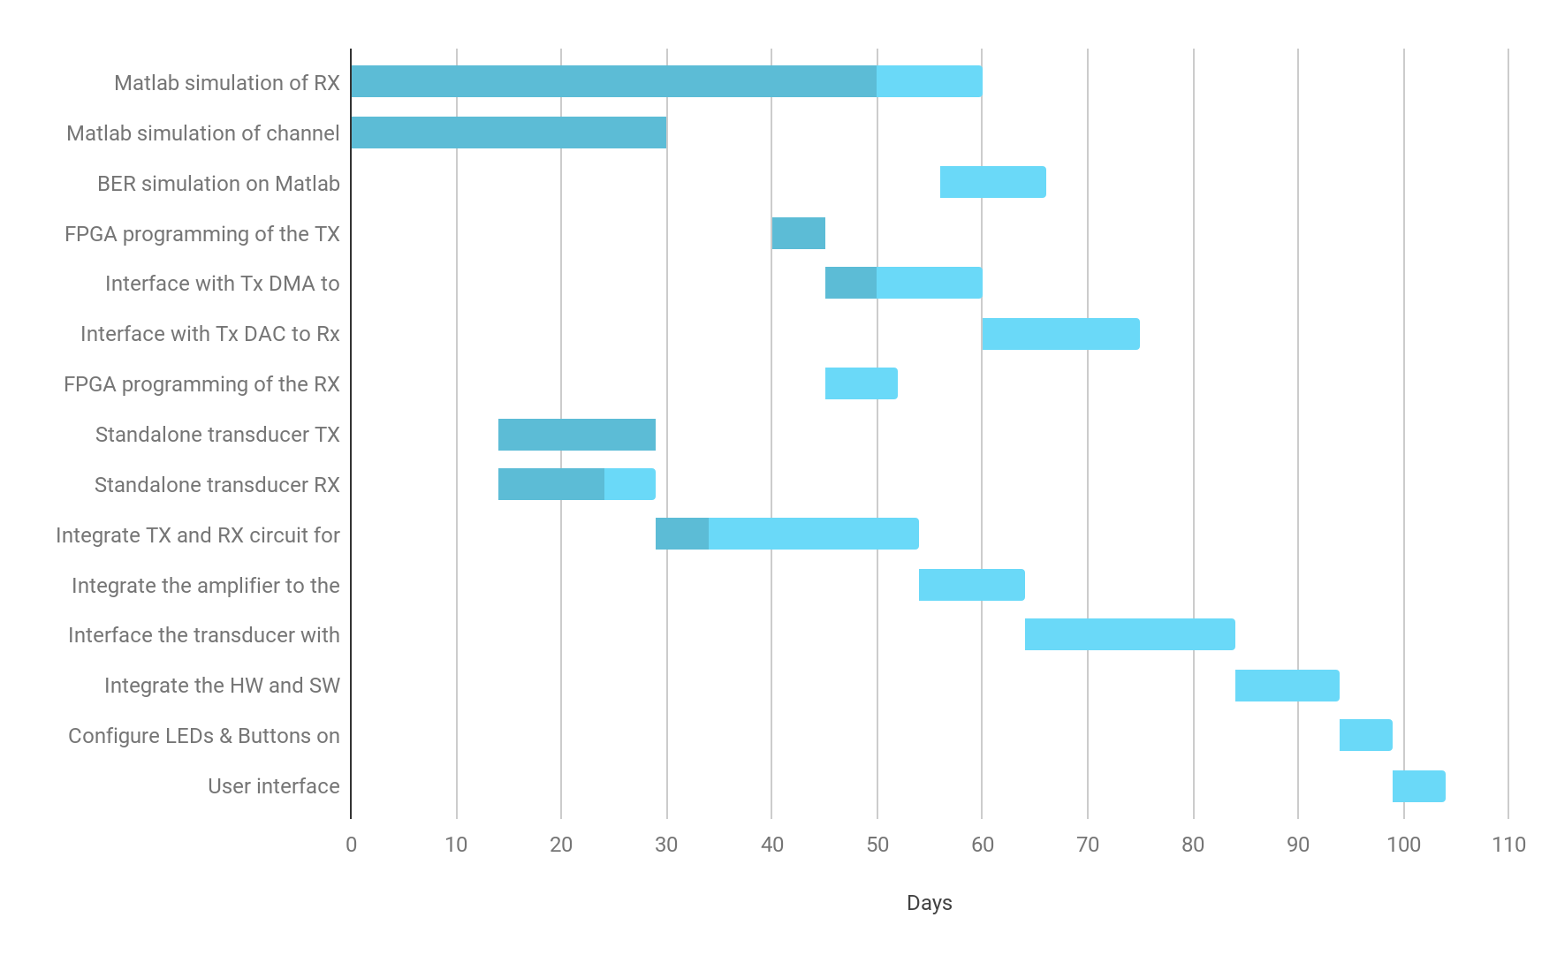
Project Milestones
Matlab Simulations on Schedule
Hardware is behind schedule
Expected Completion June 3rd

Slide 23
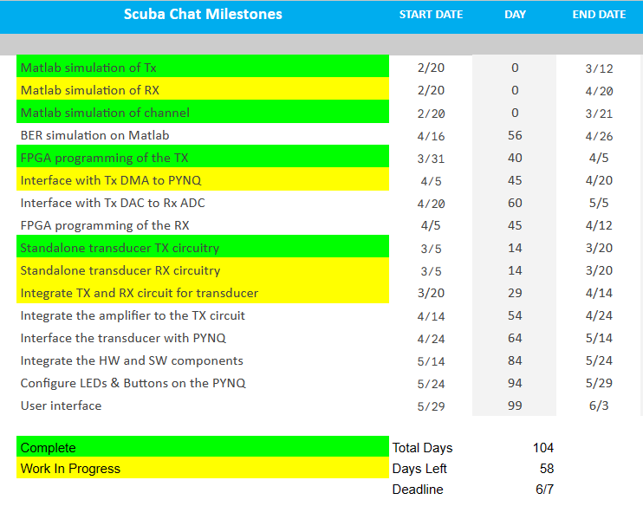

Slide 24
Questions/Comments/Concerns

